Slide 1
USB Driver for AVR
(sort of)
Επιβλέπων: Γιώργος Αλεξανδρής
Παναγιώτης Κατσαλίφης
Φίλιππος Αλέξανδρος Πλουμής
Οδυσσέας Τσουκνίδας

Slide 2
USB Protocol
4-wire: Vcc, Gnd, D- ,D+
Differential 1/ Differential 0/ SE0/ SE1
NRZI encoding
Change in state → Logical 0
No change in state → Logical 1
Low/Full Speed and more (Superspeed, Superspeed+)

Slide 3
State | D+ | D-
Differential 1 | H | L
Differential 0 | L | H
SE0 | L | L
SE1 | H | H

Slide 4
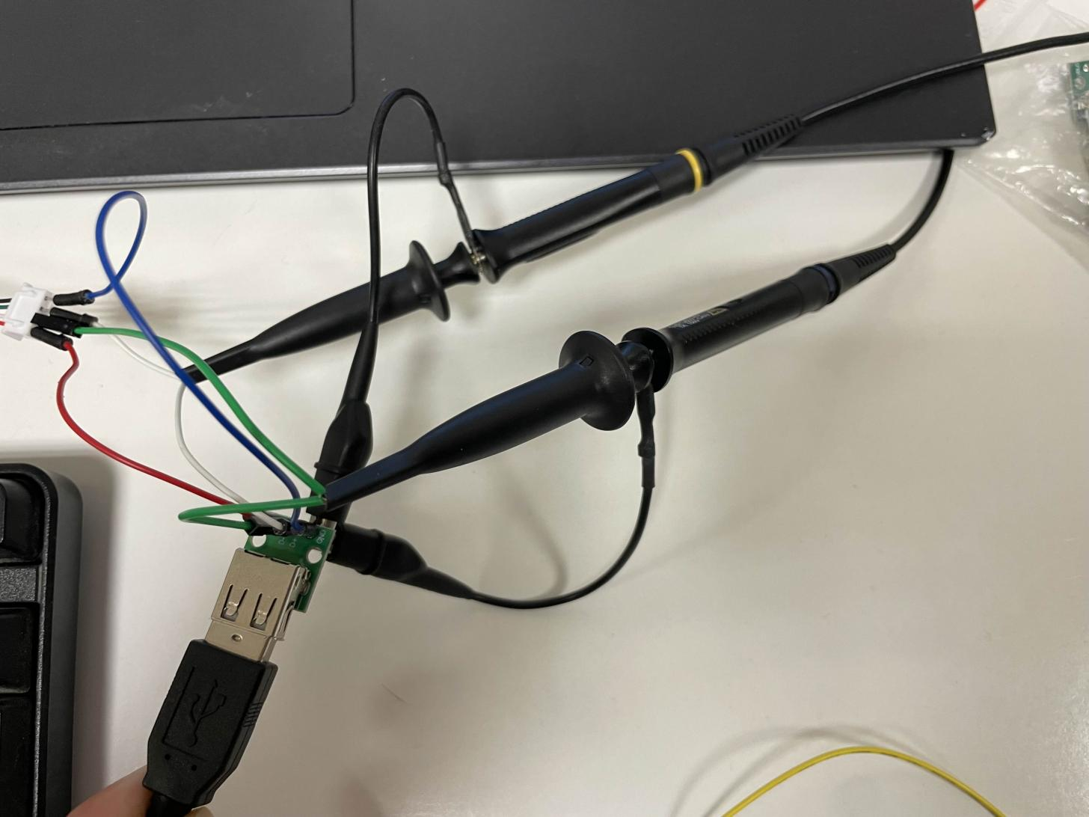
Desktop - Keyboard Connection with USB

Slide 5
USB Transactions
Control/ In/ Out Transactions
Setup/ Data/ Status Stage
Token/ Data/ Handshake Packet
Each packet field is in Little Endian
Complementary PID
Bit Stuffing every 6 consecutive 1s
5bit/ 16bit CRC

Slide 6
TOKEN | SYNC | PID | ADDRESS | ENDPOINT | CRC | EOP
DATA | SYNC | PID | PAYLOAD | CRC | EOP
H/S | SYNC | PID | EOP

Slide 7
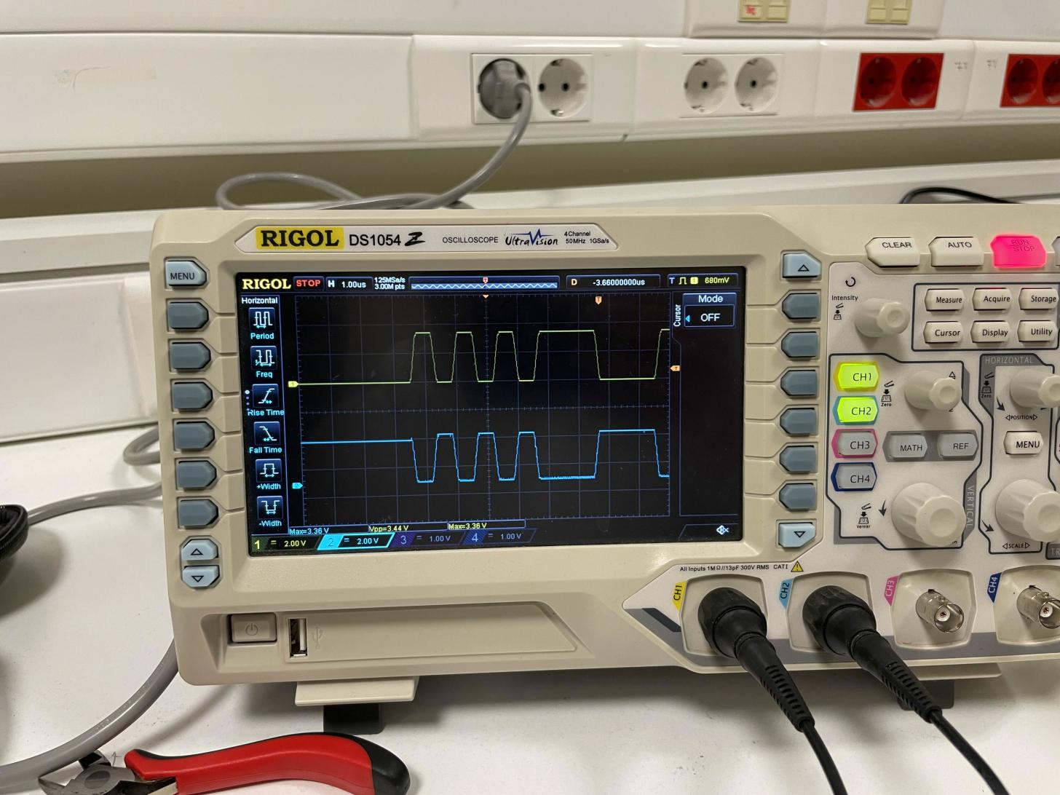
SYNC PATTERN

Slide 8
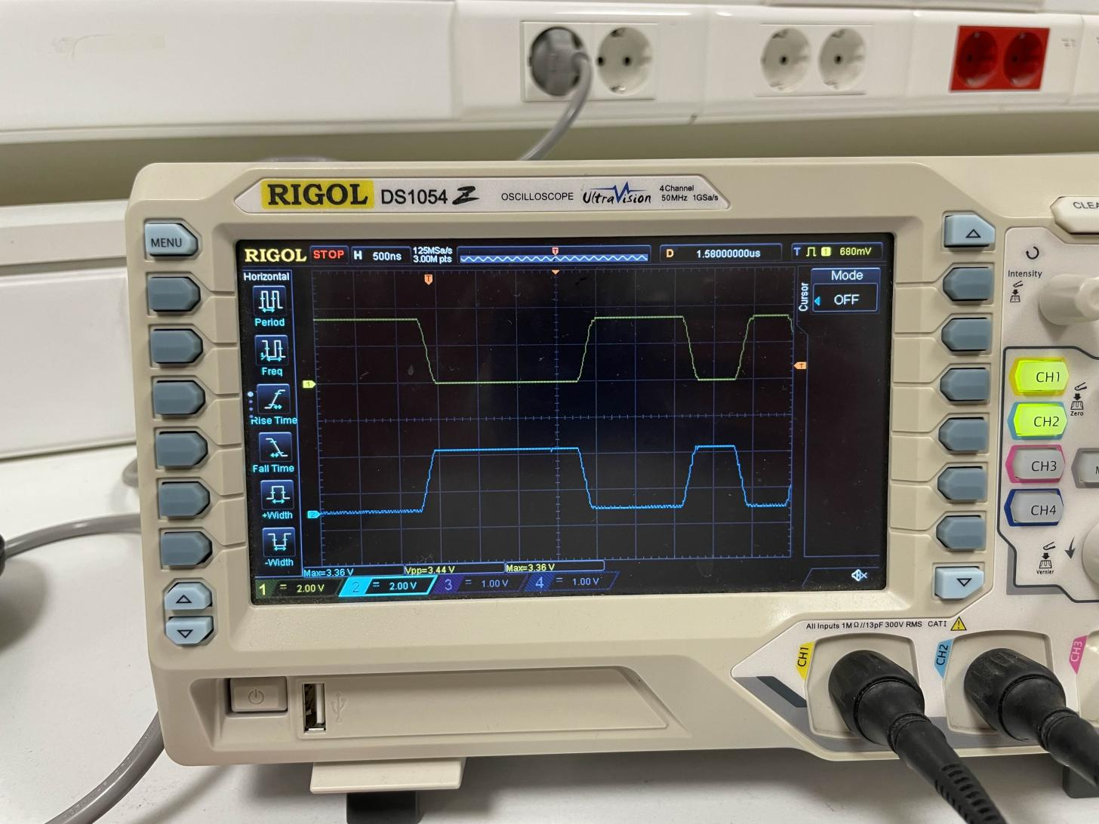
PID Field

Slide 9
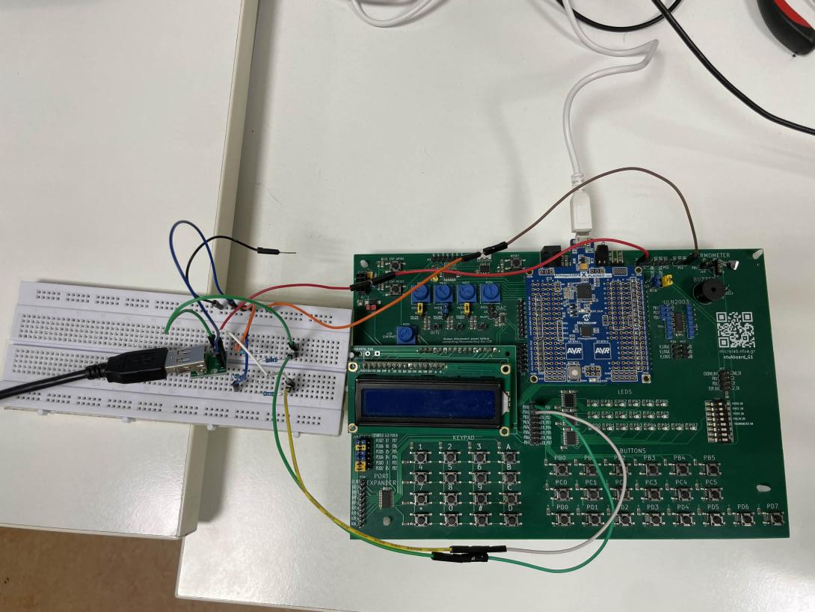
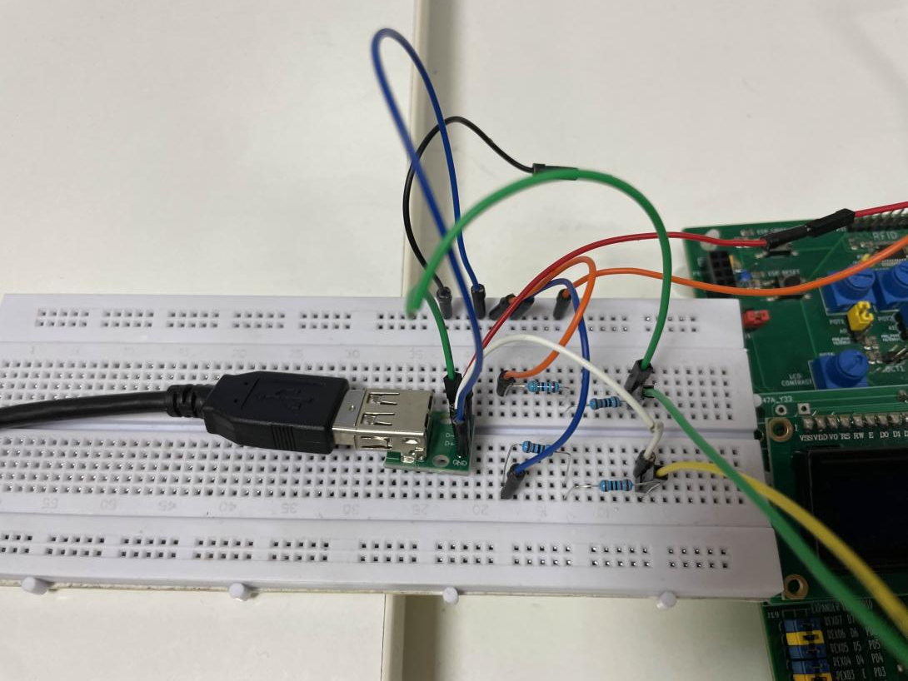
Attempt(s) at AVR - Keyboard Communication

Slide 10
Why Did We Fail?
Difference in voltage from AVR?
Couldn’t match/synchronize frequency?
Faulty Configuration?

Slide 11
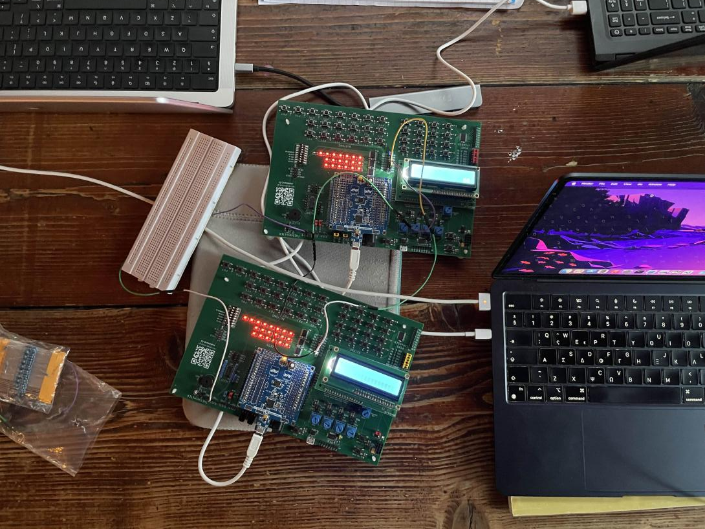
Backup: Simulating Keyboard with another AVR

Slide 12
Sources
Universal Serial Bus Specification
USB 101: An Introduction to Universal Serial Bus 2.0 by Robert Murphy
USB in a NutShell, Beyond Logic
Ben Eater
USB HID Keyboard scan codes

